Slide 1

KIOSK STANDARDS AND IDEAS
UPDATED JUNE 28, 2011
Columbia Forest District Office

Slide 2
Agenda
Introductions
Review standard for small Kiosk
Review 10 Elements of a Kiosk Sign
Review Proposed Layout Template
Review mock ups

Slide 3
Small Standard Kiosk -Template
Put in covered Kiosk -permanent or free standing
Dimensions- 91.5 cm by 91.5 cm or (3 ft x 3 ft)
Layout:
  Recreation Site and Trails Log in top left hand corner
  Green background
  Generally text on left, map on right

Slide 4
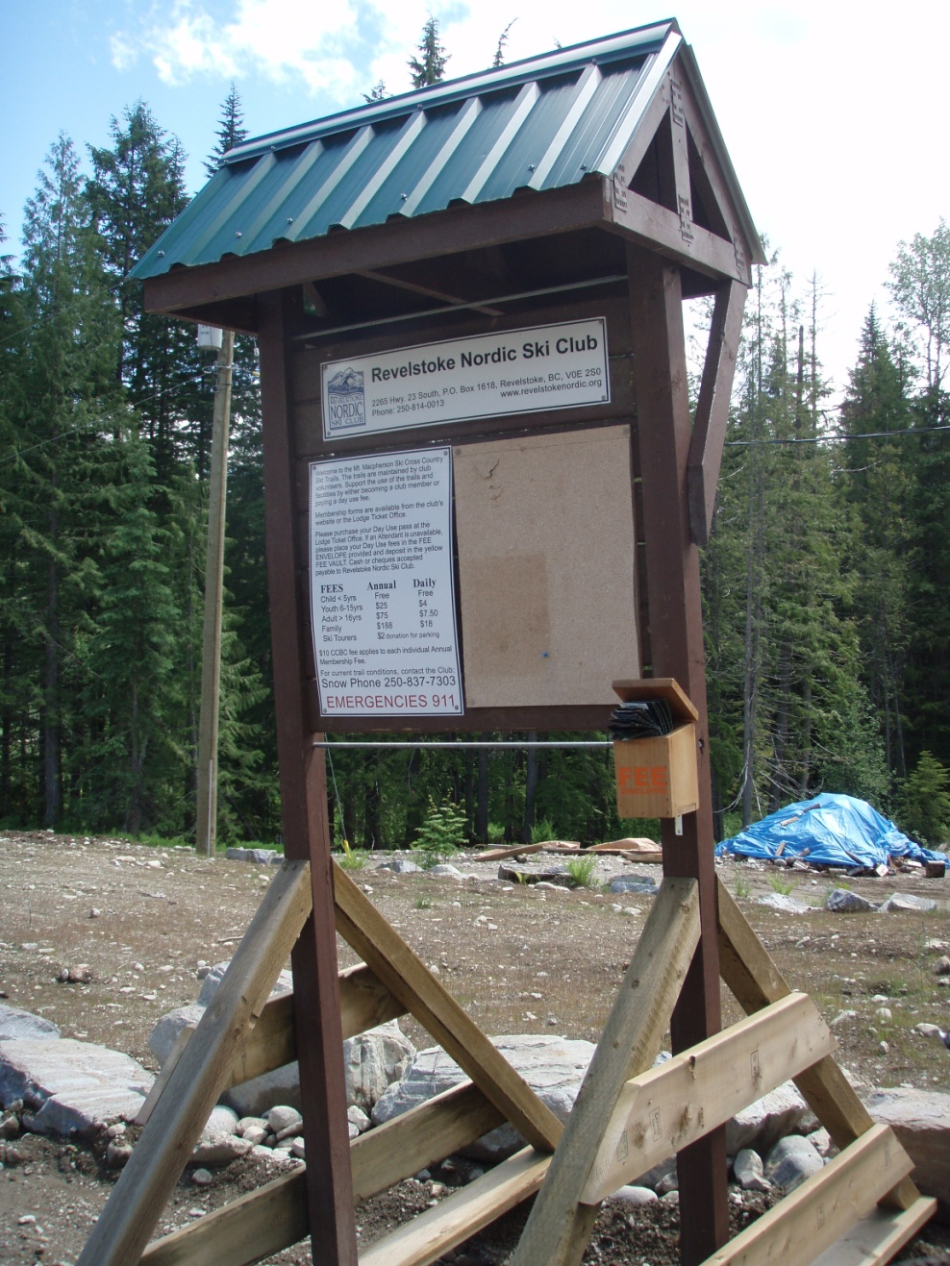
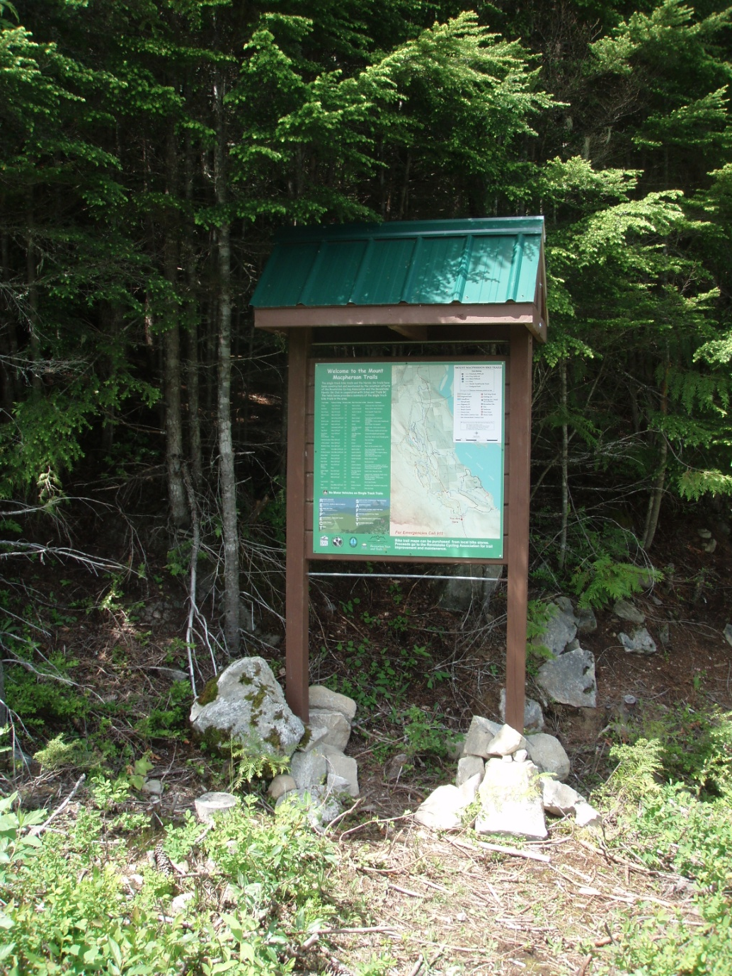
Standard Small Kisk

Slide 5
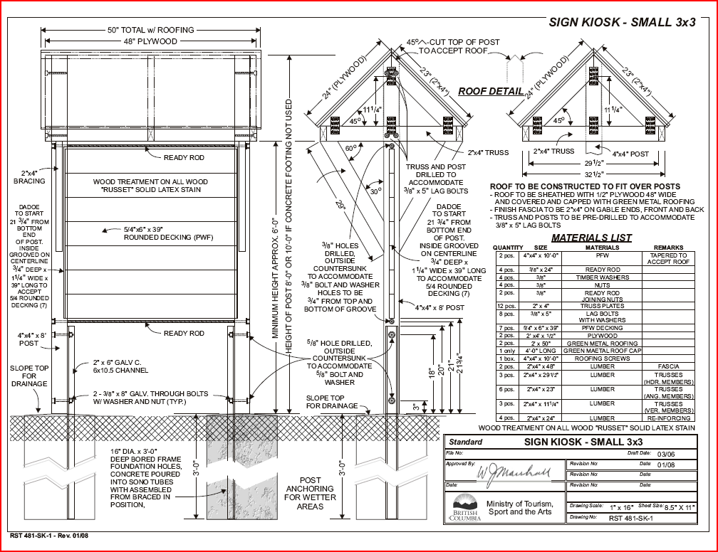

Slide 6
Standard Large Kiosk
Frame size is 4 feet high by 7’ 9” wide so make sign
  3” 11” high by 7’wide
  Or use 2 3ft x 3 ft kiosk side by side

Slide 7
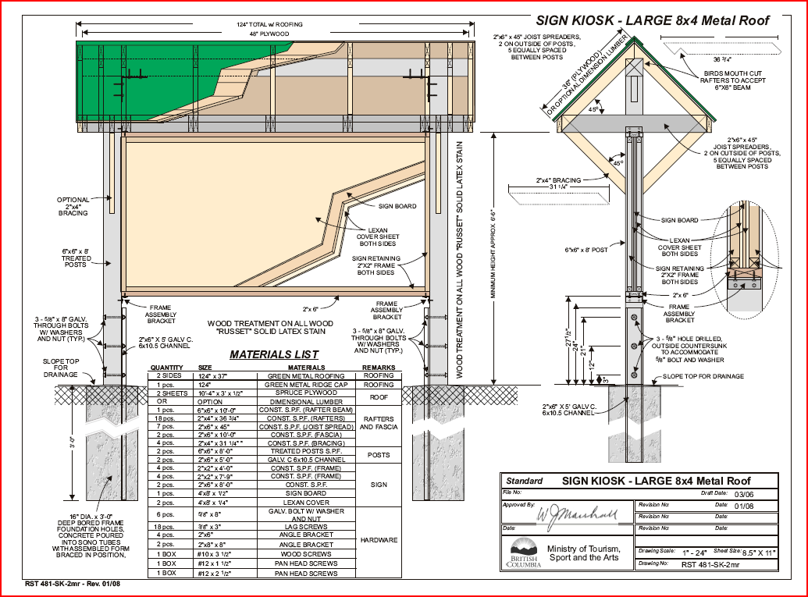

Slide 8
10 Element of a Kiosk Sign (IMBA)
Map
Trail Information
Emergency Contacts
Location Identification
Volunteer Information
Trail Difficulty Ratings
Risk and Hazard Warnings
Responsible Trail Etiquette Tips
Rules and Regulations
Interpretive Information

Slide 9
KEY DIRECTION
KISS (Kiss principle)
Use Icons over words
Try not to be repetitive
Consistent appearance
Consistent messaging
Less words is better

Slide 10
Map
Made by Robyn at an appropriate scale given space
Will show contours with hill shade
Will Contain
  Map Legend
  North arrow
  Scale bar
  Trail rating legends
  Other basic legends
Need to Standardize for Province

Slide 11
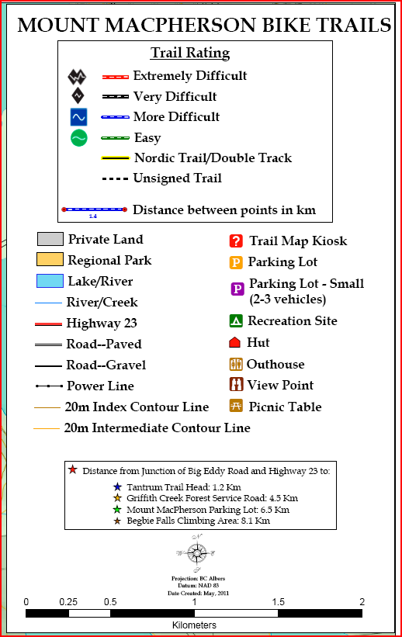
Map Legend
Need to Review with Provincial symbols and colours

Slide 12
Trail Information
  Robyn can supply distances for different trails if requested.
  Would be great if club could supply:
    description / technical rating
    brief descriptions ex nature of the trail / it’s destination.

Slide 13
Emergency Contacts
For Emergencies call: 911
Report Wildfires at 1-800-663-555 or *5555 from a cell phone

Slide 14
Location Identification
The map will have a “You Are Here” point marked- thus we need to know the location of the Kiosk.
Please provide a Google Earth kml placement file or GPS coordinate

Slide 15
Volunteer Information
Club logos-Please supply
A statement that the trails are managed and maintained by the volunteer efforts of ._______club in cooperation with Recreation Sites and Trails BC.
or better still
  These trails have been constructed and are maintained by the ____________Club.

Slide 16
Trail Difficulty Ratings
Consider adding with specific trail information. (Length, Nature etc)
For intensive use trail provide at table.
  Use Icons for technical ratings rather than words. (Cross-reference icons with words in map legend)

Slide 17
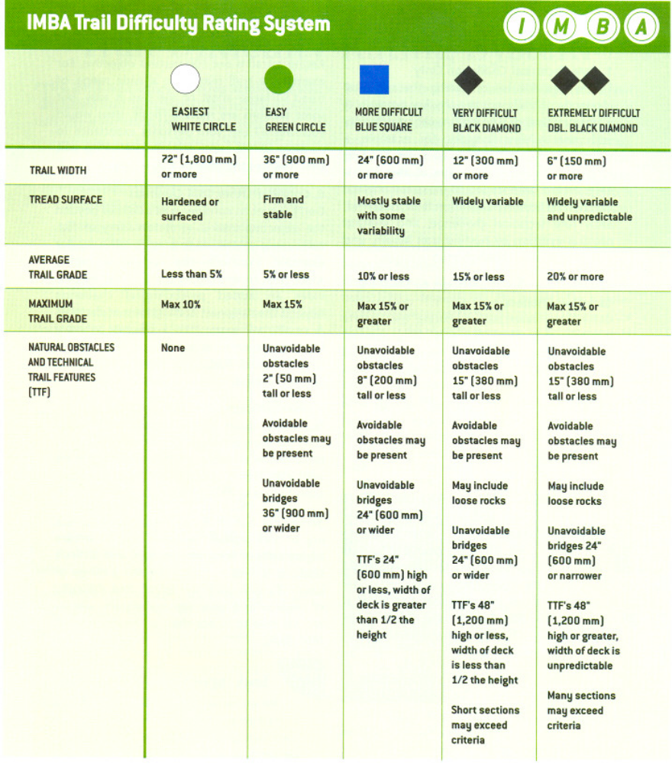
For Mountain Trails

Slide 18
Risk and Hazard Warnings
On multi use trails
  Share the Trail
Bear aware with paw

Slide 19
WILDFIRE MESSAGING?
???
Report Wildfires at 1-800-663-555 or *5555 from a cell phone

Slide 20
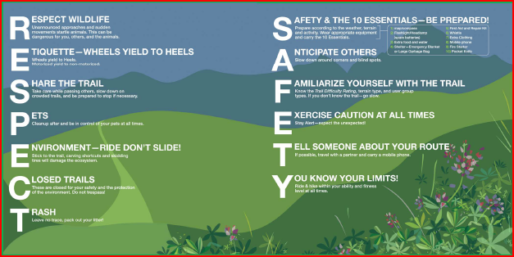
Safety / Responsible Trail Etiquette
Too Wordy??

Slide 21
Safety / Responsible Trail Etiquette
Need to Revamp
Address multi use
Summarize to a few key points
Should have a picture or Art Work Background

Slide 22
OTHER EXAMPLES-BIKE PARK
Wear your helmet , gloves, and protective equipment
Always ride in the same direction
Respect other riders; share the trail
Stay on the trail
Keep the trails clean
Ride don’t slide

Slide 23
Rules and Regulations
Generic-All signs
(For all bike, Motorcycle and ATV trails)
  Prior to using trail please clean your vehicle of any vegetation to prevent the spread of noxious weeds.
Specific –see those listed for each area (They are a result of main use and approval conditions)

Slide 24
KEY MESSAGES
These trails are in the working Forest (With picture of logging truck)
Or
We work with our stakeholders

Slide 25
PROOFS
Clubs can work directly with consultant who will work with Robyn or a mapping consultant.
Clubs will be given 2 proofs to review.

Slide 26
WANTED FROM CLUB?
Club information / Logos
Trail Descriptions / Technical ratings
Etiquette?
Recommend / Comment on rules
Note land manager gets final say on rules

Slide 27

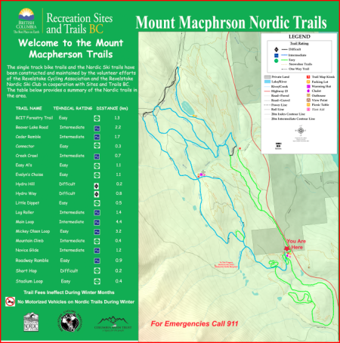
Example
Finished Sign
Basic Template

Slide 28
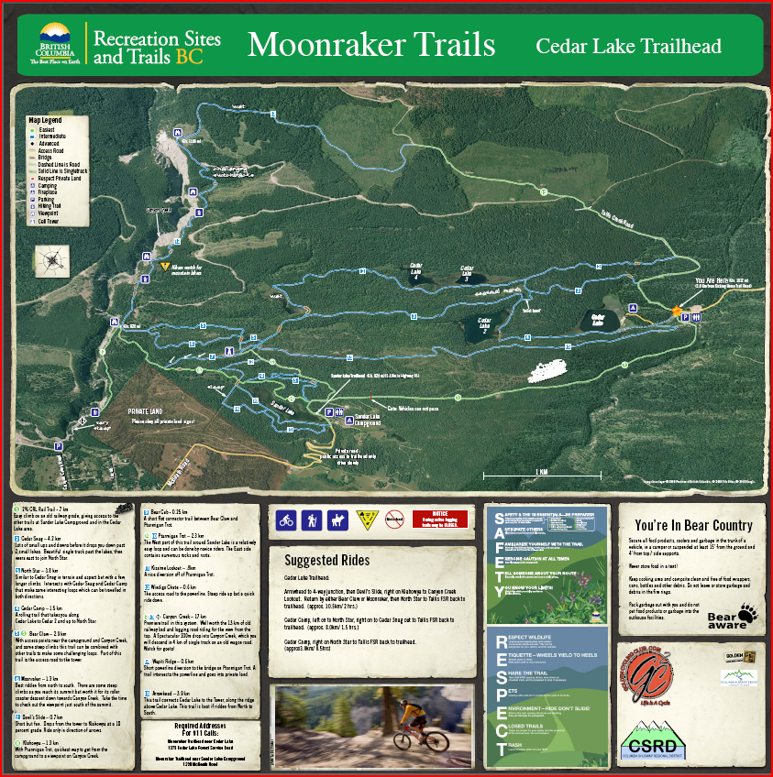
Example

Slide 29
NAME OF RECREATION SITE
Club acknowledgement
Map
Legend
Description of Trails
Trail Etiquette
Key Messages/ Cautions
Section 20 Rules
Club
Logo
Emergency Info

Slide 30
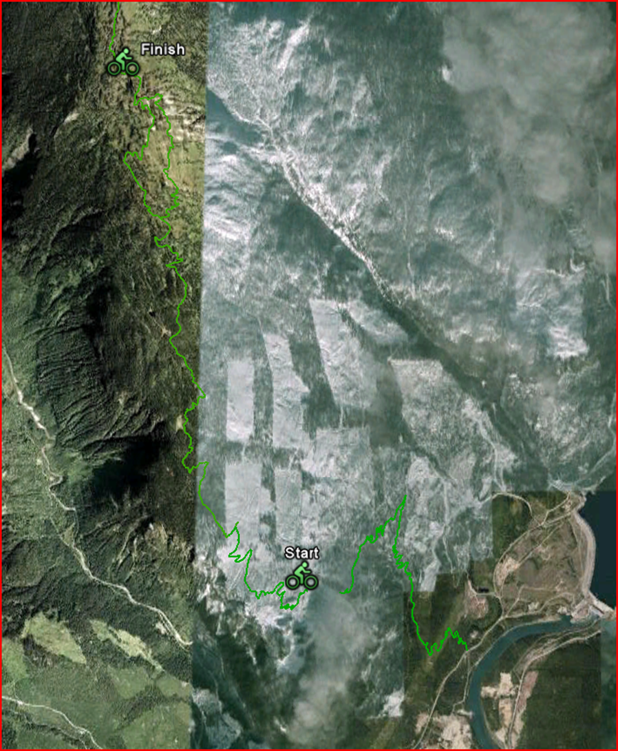

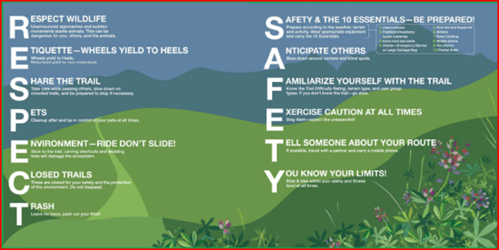



FRISBY RIDGE BIKE TRAIL
This trial has been constructed and is maintained by the Revelstoke Cycling Association.
The trail follows Frisby Ridge. It is about __ km long starting in subalpine forest at ____ m Most of the trial is in the Alpine with its destination at a small alpine lake at ____ m
-Share the trail
-You are in important Mountain Caribou habitat. Please stay well away from this endangered species.
-This trail is closed from June 1- July 15 to facilitate wildlife habitat protection
-Please clean bike of vegetation prior to use to prevent the spread of noxious weeds..
-Bike must be kept on trail.
-Report violations to 1 866 837 7611
Out and back Mountainous weather?
For Emergencies call 911
Report wildfires at *5555

Slide 31
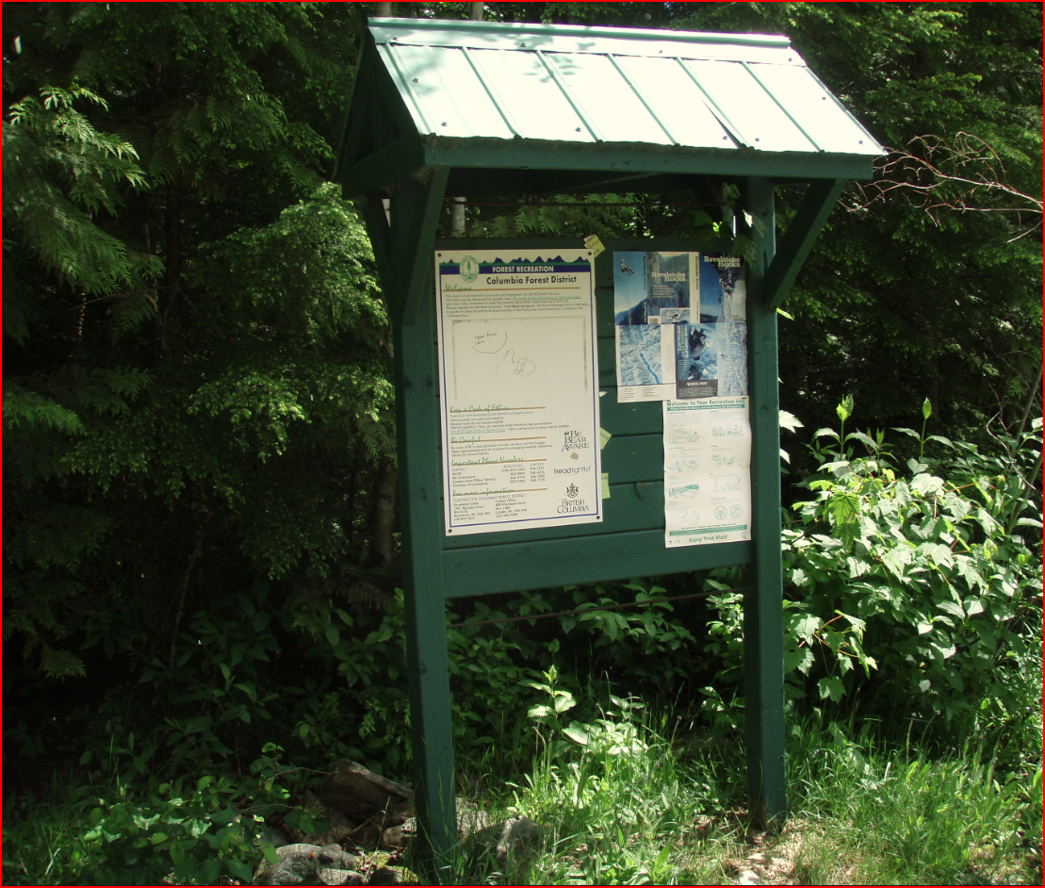
BEGBIE BLUFFS

Slide 32
Begbie Kiosk (From Oct 14, 2010 Meeting)
Would have a theme associated with hiking and climbing
Would focus on the bluffs between the falls and the Highway 23 parking lot
Would show major and minor trails and the location of various walls and cliffs
The kiosk should have a bulleting board associated with it.
Nothing on Rocks

Slide 33
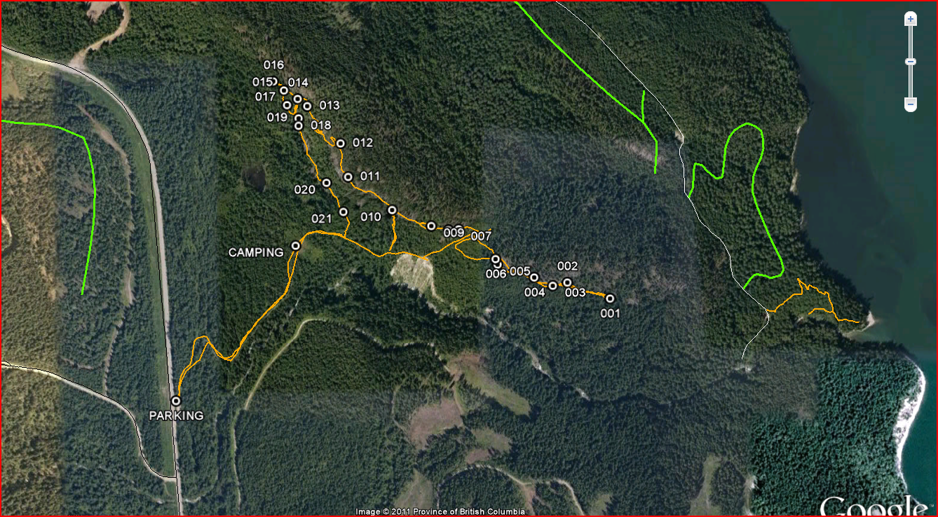
BEGBIE BLUFFS RECREATION SITE
-Many of the routes have been put in by local climbers. Guide books can be purchased from
Cyclist parking is limited please park at the Macpherson trail head parking lot.
Share the Trail
These trails are in the
working Forest
For Emergencies call 911
Report wildfires at *5555

Slide 34

Trail Signs
NEED A SIGN PLAN
To show location of trails to various walls
Each location to specify trail names and associated direction of Arrows

Slide 35
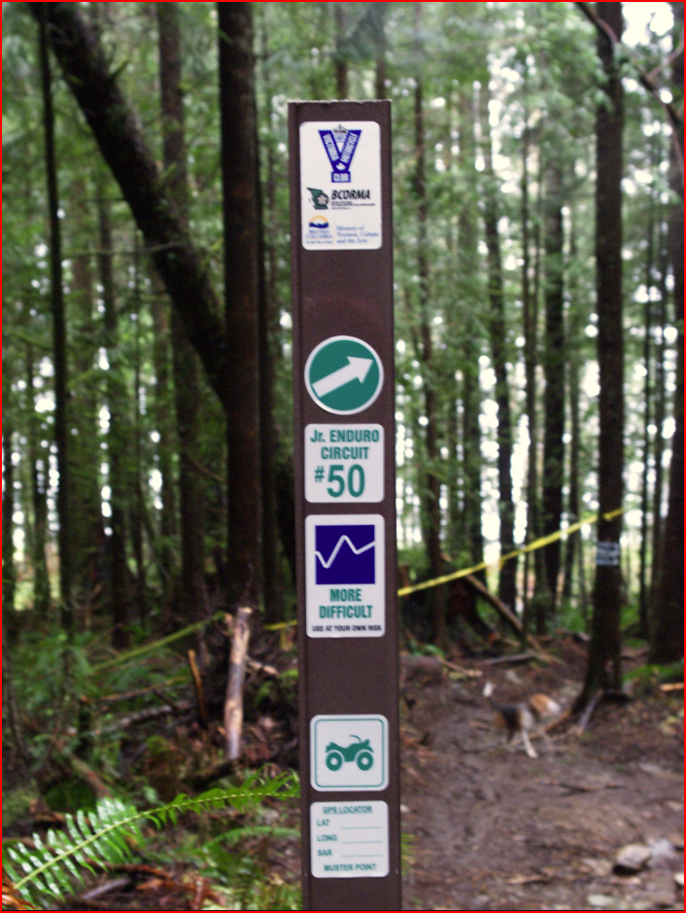
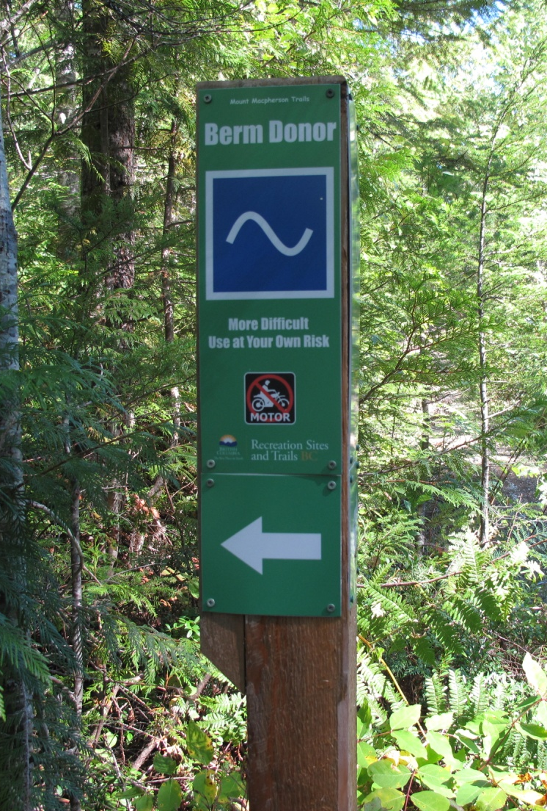
FIBREGLASS VS WOOD
For front country use wood –For backcountry use fibreglass

Slide 36
Sproat Mountain Hiking and ATV Trail
The ATV trail and lookout maintained by Revelstoke ATV club in cooperation with the Ministry of Forests Lands and Natural Resources Operations

Slide 37
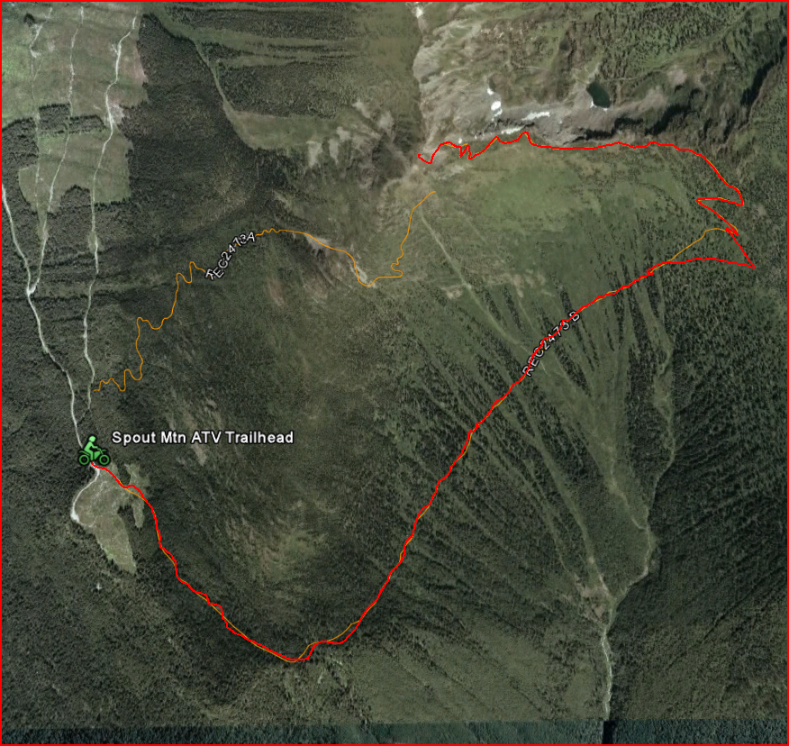

SPROAT MOUNTAIN ATV AND HIKING TRIAL
The ATV trail and lookout are maintained by Revelstoke ATV club in cooperation with the Ministry of Forests Lands and Natural Resources Operations.
Hikers will enjoy the hiking trial better. Cyclist the ATV trail will work better for you.
Trails are closed from March 15 to July 15 to facilitate Wildlife habitat protection.
To prevent the spread of noxious weeds please clean your vehicle of all vegetation prior to proceeding.
Vehicles are restricted to Trail and Parking areas.
All vehicles are to be kept on the trail.
-Report Violations to 1 866 837 7611 (Tool free)
-
For Emergencies call 911
Report wildfires at *5555

Slide 38
THOUGHTS?

Slide 39
Mount Macpherson Parking Lot
Nordic Club / Bike Club
Clubs have requested 2 double kiosks-One for each club
Try to use same layout theme but bigger

Slide 40
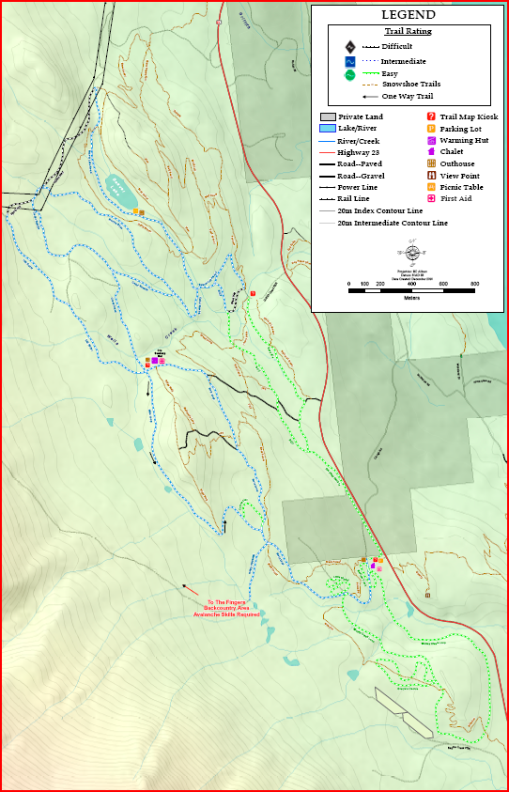
Nordic Club Map

Slide 41
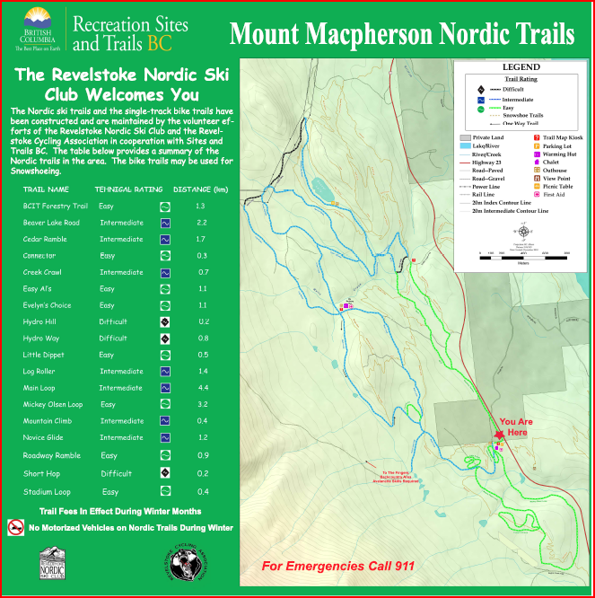
Current Kiosk

Slide 42
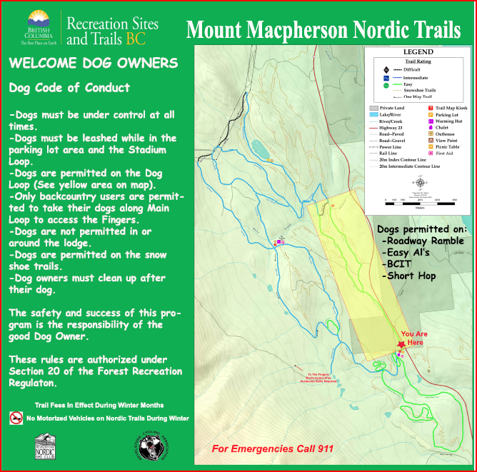
Current Kiosk
Dog
Rules

Slide 43
Section 20 Rules
No Snowmobiles
Trail Fees
Parking Fees (Voluntary)
Dog Rules
Early Morning Parking?
Snowshoe rules?
Report violations

Slide 44
OTHER
THESE TRAILS ARE IN THE WORKING FOREST

Slide 45
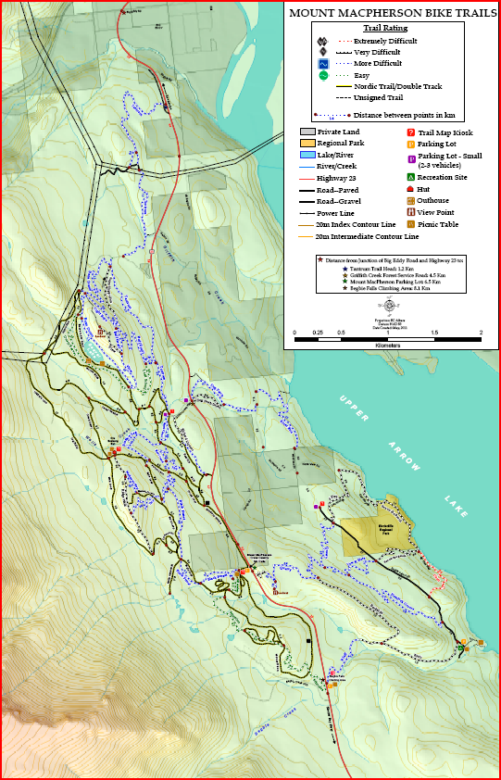
Mountain Bike Trail Map

Slide 46
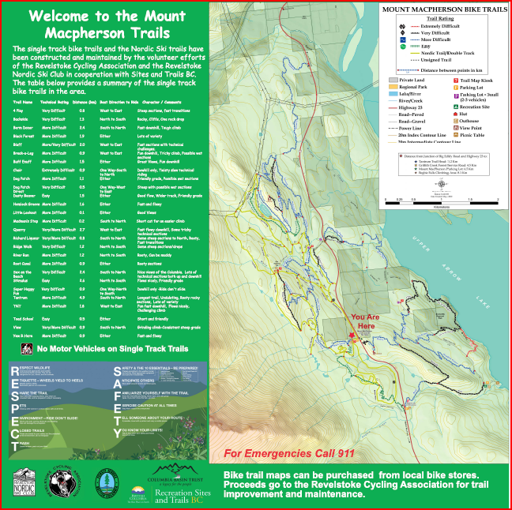
Current Kiosk

Slide 47
MESSAGES
No motorized on Single Track
Clean vegetation prior to use to prevent noxious weeds.
Share the trail
These trails are in the working forest
Report wildfires

Slide 48
KEYTONE STANDARD BASIN

Slide 49
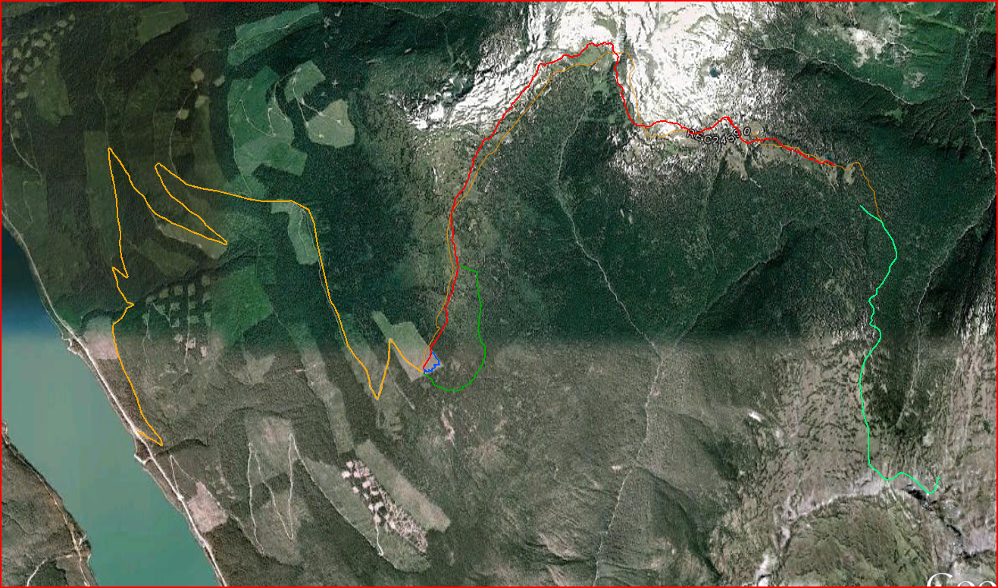
KEYSTONE STANDARD BASIN TRAIL
Trail Description
Share the trail
You are in important Mountain Caribou habitat. Please stay well away from this endangered species.
Please clean bike of vegetation prior to use to prevent the spread of noxious weeds.
Bike must be kept on trail.
Report violations to 1 866 837 7611
For Emergencies call 911
Report wildfires at *5555

Slide 50
Gorge Creek
Need to talk to CSRD (Kevin Clarkson)and people managing Last Spike Heritage Site

Slide 51
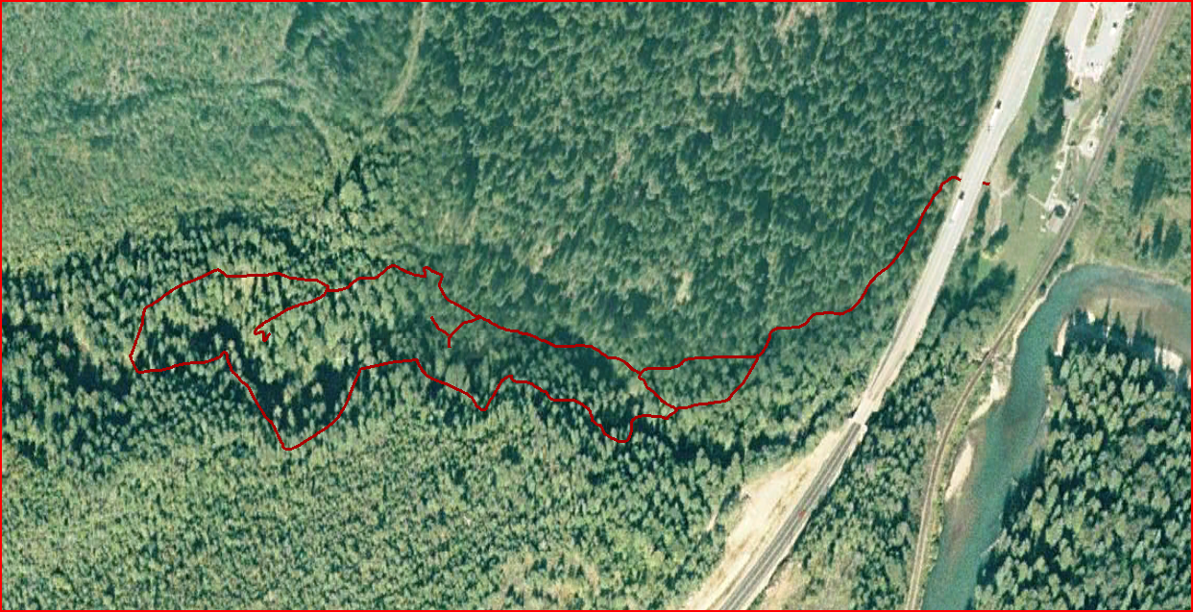
GORGE CREEK TRAIL
Last Spike Heritage Site
Trail Description
Use caution when crossing the Trans Canada Highway
Hikers only-No bikes or motorized vehicles
These trails are in the
working Forest
For Emergencies call 911
Report wildfires at *5555

Slide 52
WESTSIDE MOTORCYCLE TRAILS
Signage to help out with acceptance
Signage for directing people to the track
Signage for asking people not to unload or use certain trails

Slide 53
THOUGHTS?

